Slide 1
Python script for monitoring in Linux
BY PETER DAŇO

Slide 2
Assignment
Implement script which monitors
Free space on file system
Running processes
Current logged in users
Anything else I consider important
Format the output
Format the output text
Put it into the a table
Send the table by mail
Transform the table into HTML
Send the final table with all the data into the recipient’s mail

Slide 3
Motivation
Why monitoring
To maintain the stability and functionality
To detect security threats and vulnerabilities
Capacity planning
Why to automate
Faster feedback
Consistency
Improved accuracy

Slide 4
Prerequisites
Linux distribution (tested on RedHat)
Standard Linux commands(df, ps, who, etc…)
Cron
Python
SMTP server
Internet connection

Slide 5
Resources
Linux manual
Cron docs
Gmail SMPT docs
Python docs
Python package index

Slide 6
Script monitoring
Disk usage
Process count
Currently running processes
CPU usage
RAM usage
Currently logged users
System uptime
System load

Slide 7
Disk usage
Uses a python library to get output from the command
Command df displays the information about the systems disk usage

Slide 8
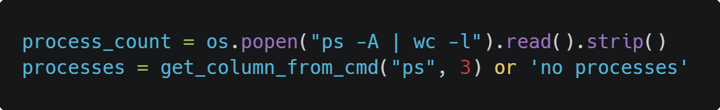
Process monitoring
Using python os library
Linux commands ps and wc
Function get_column_from_cmd
Command displays currently running processes and their count

Slide 9
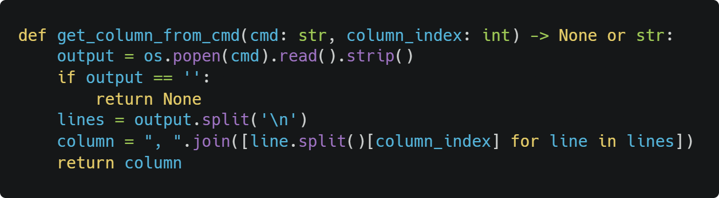
Function get_column

Slide 10
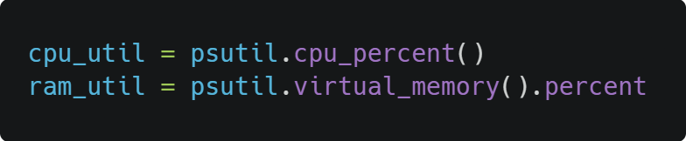
CPU and RAM usage
Using python psutil library
No Linux commands
Command displays current cpu and ram usage

Slide 11
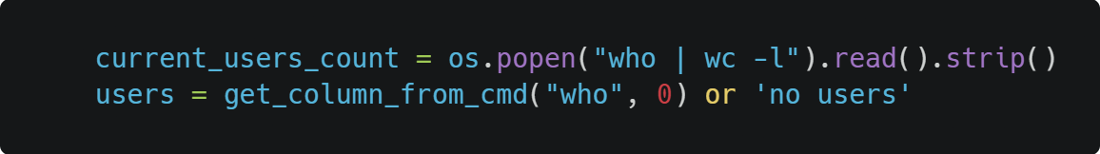
Users list and count
Using python os library
Linux commands who and wc
Function get_column_from_cmd
Command displays currently logged in users and their count

Slide 12
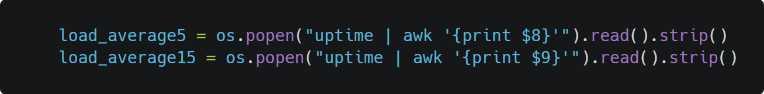
Average load
Using python os library
Linux commands uptime and awk
Command displays average load for last 5 and 15 minutes

Slide 13
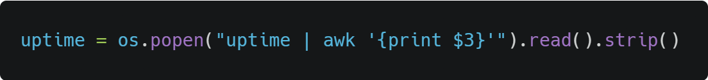
System uptime
Using python os library
Linux commands uptime and awk
Command displays current system uptime

Slide 14
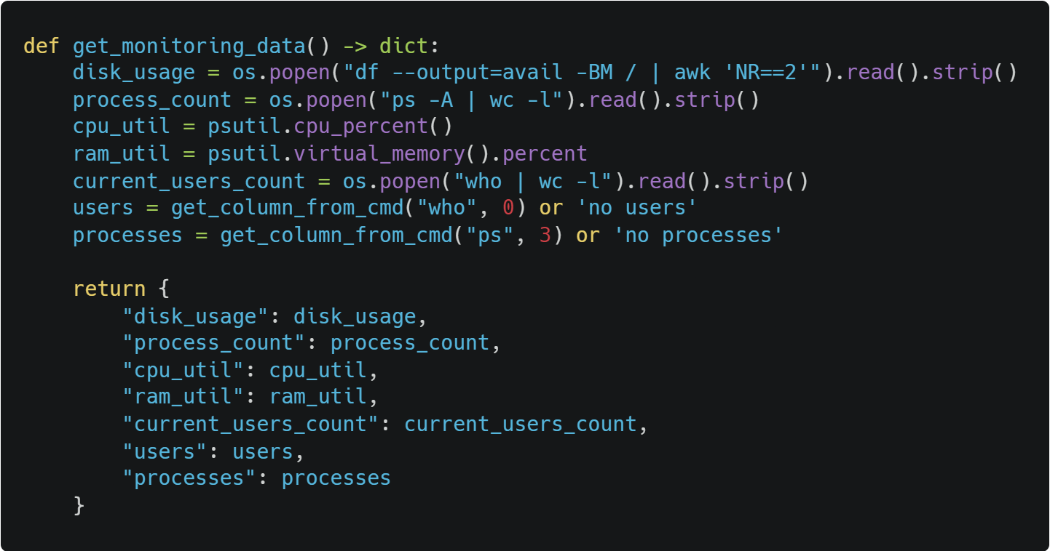
Commands in function

Slide 15
Format the output
Format the data into a readable form
HTML templating
Creating a table
Filling the table with data from the monitoring

Slide 16
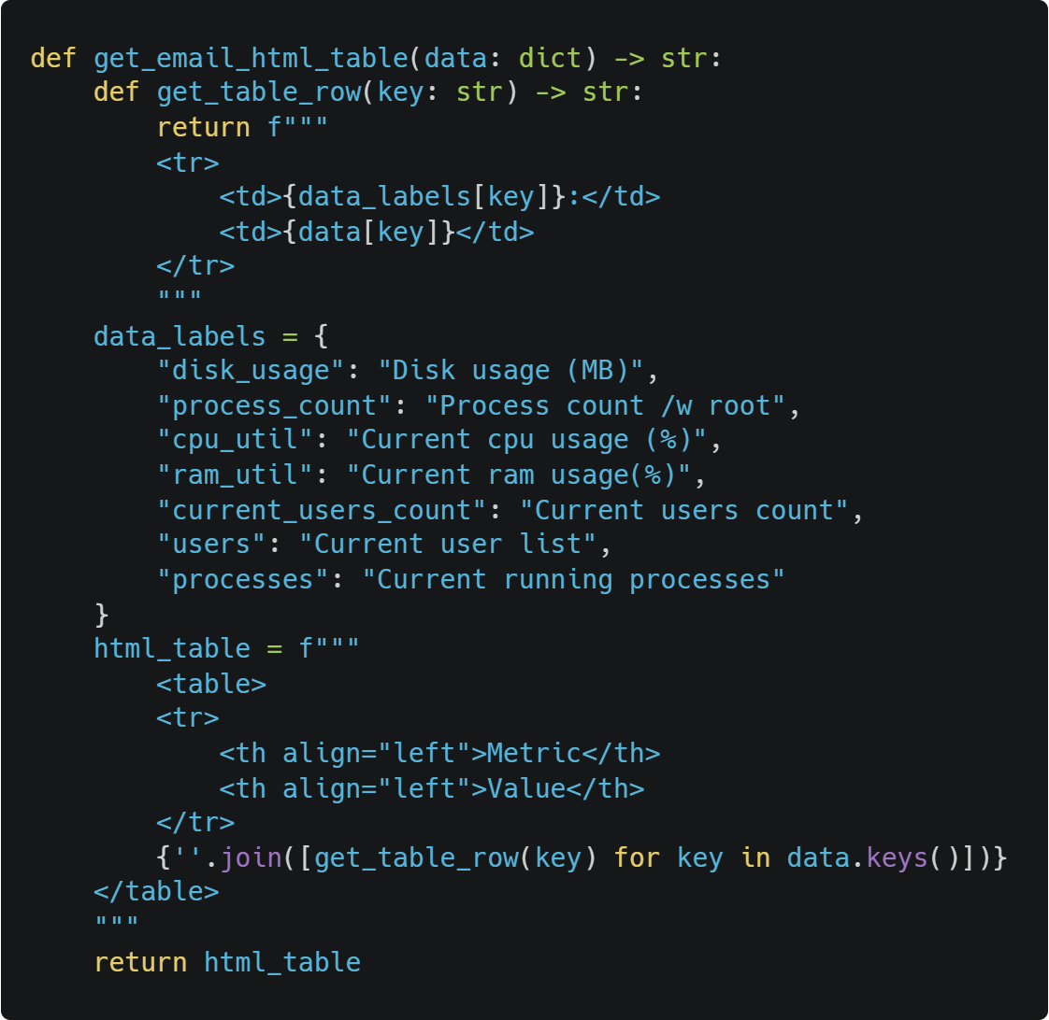
Creating the table
Using no external libraries
Using HTML to create the table
Puts all the data from the monitoring
into a formatted table

Slide 17
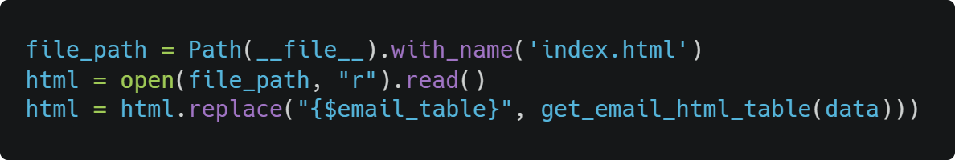
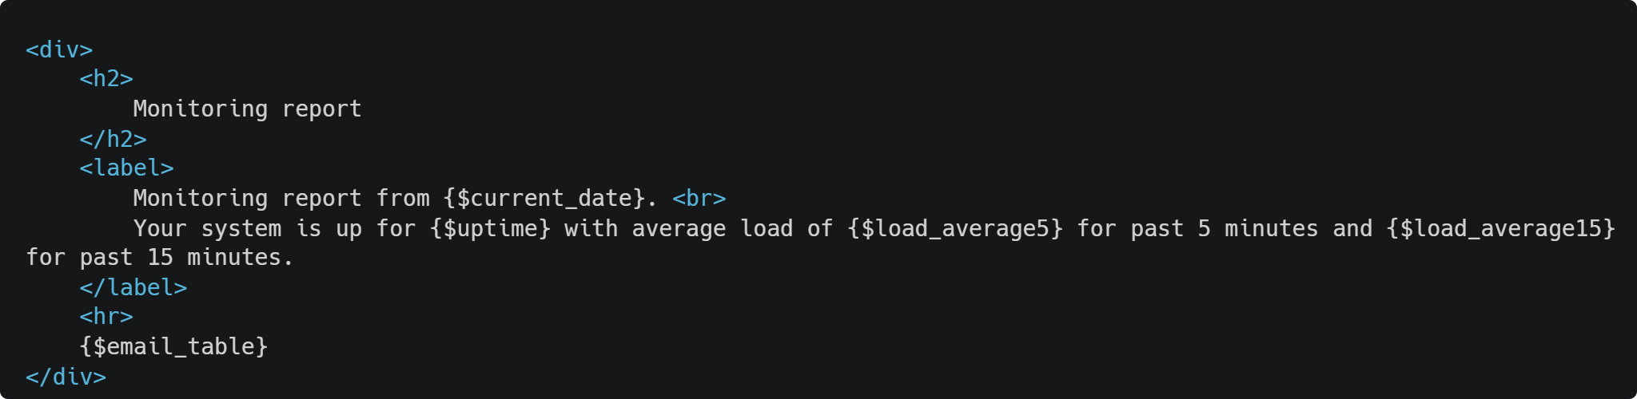

Slide 18
Send the table to mail
Send the table with the data to mail
Using SMTP server
Using gmail SMTP
Using os variable
.env file

Slide 19
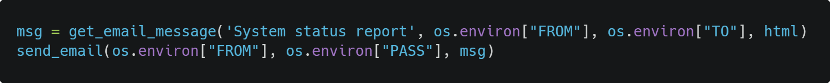
Sending the mail
Using python smtp library and MIMEText library
Using gmail SMTP
Using my own mail as SMTP service
Using get_email_message() and send_mail()
Loading login and password from os variables from .env file

Slide 20
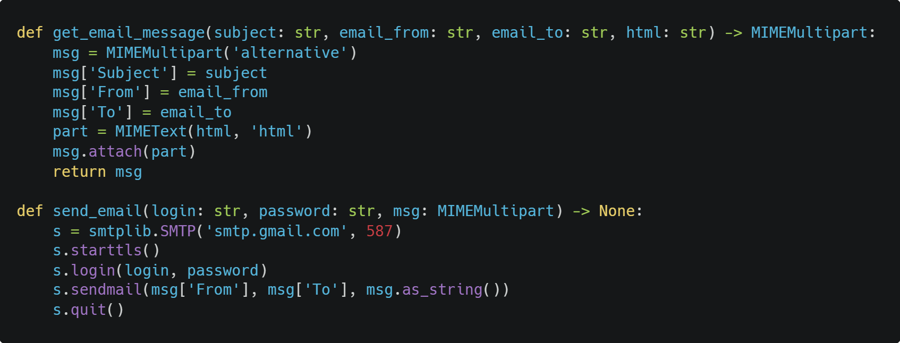
MIMEText and SMTP

Slide 21
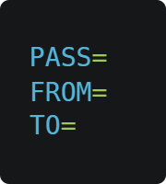
OS variables
.env file
Better than hardcoded passwords
Stored locally

Slide 22
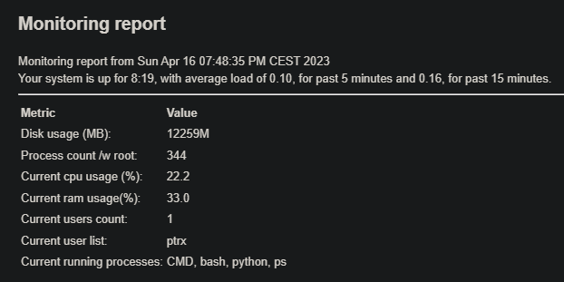
Sample output

Slide 23
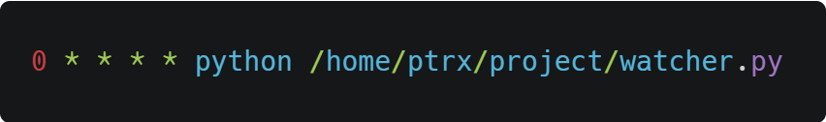
Cron
Job scheduler on Linux
Used to automate the script
Script sent every hour in example

Slide 24
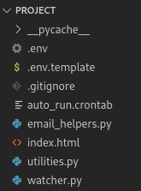
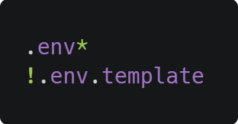
Code structure
Split into multiple files
Better readability
Easier to change
Used git as version control
https://github.com/PetriixD/academy_project

Slide 25
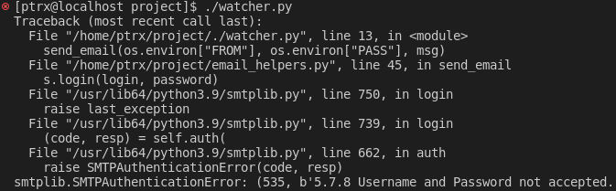
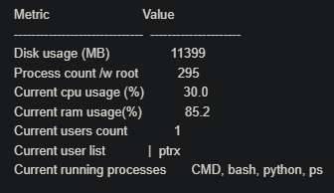
Problems
Gmail SMTP security
Python tabulate library
Spacing in Linux vs Windows
Cron executing python permissions
Cron path to execute the script

Slide 26
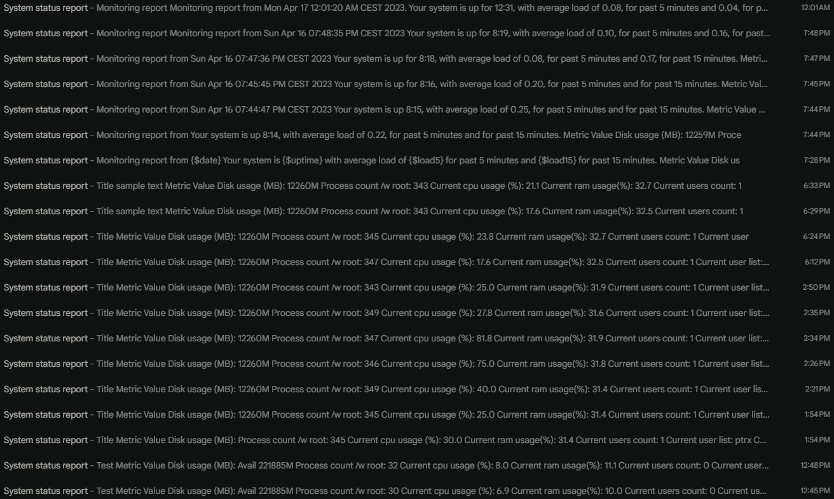
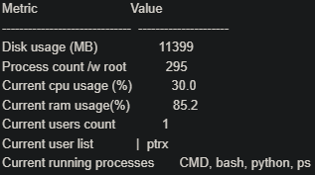
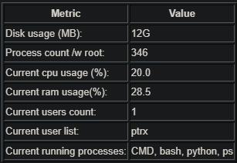
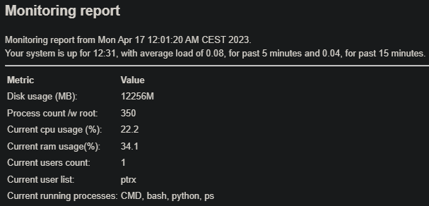

Slide 27
Tools
VMWare
Alma Linux 9
Visual Studio Code
Carbon - code images

Slide 28
Summary
Monitoring server performance
Research
Get data from Linux
Create table with the data
Send the output table to mail
Automate

